Slide 1
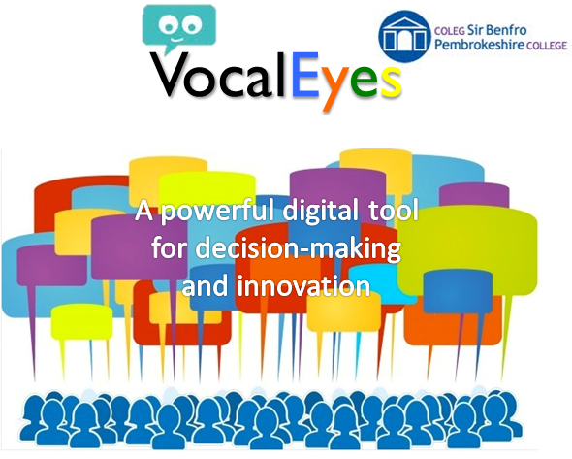
Pembrokeshire College
Engaging Staff and Students
Shortlisted for TES & College Wales Learner Voice Awards
Winner of UWTSD ISD iSustain Social Impact Award

Slide 2
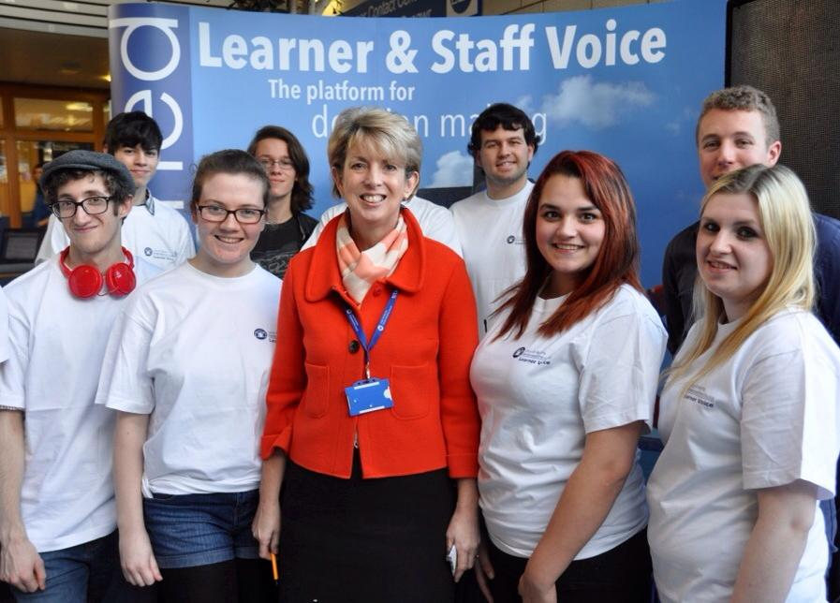
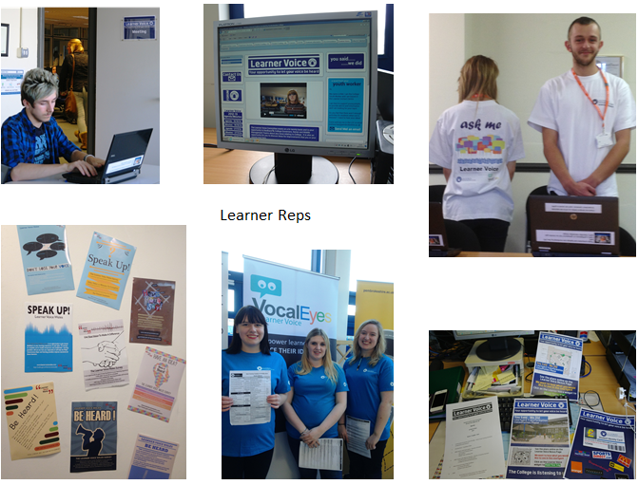
Students
Students are trained in the use of VocalEyes during induction. Course Reps promote the system with ideas being suggested, rated and debated then considered by the Student Council and SMT at regular meetings.
Ideas
Turn into
Actions
VocalEyes taps into the skills students have in using digital tools and provides evidence of engagement .
Then get reported back onto VocalEyes
Students can access by SSO (single sign-on) via college intranet homepage.

Slide 3
Staff
VocalEyes has invigorated out staff engagement involving a large proportion of staff in generating ideas that have seen real change happen at a strategic level.
Staff were invited to use VocalEyes as part of Pembrokeshire College’s Institutional Planning Day
Our Staff Forum is informed by the ideas & opinions captured on VocalEyes providing priorities and helping avoid backlash decisions.

Slide 4
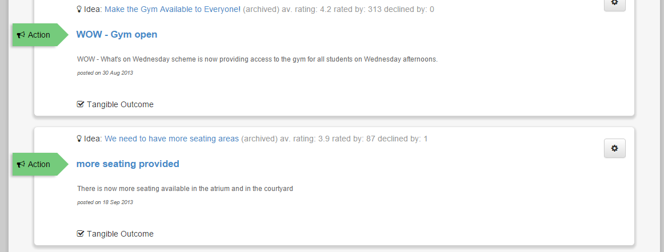
So far we have ..
*Captured over 60,000 interactions with students
*Improved Quality (thro student-generated ideas)
*Provided a feedback loop with actions published on VocalEyes
Staff: are able to use VocalEyes for meetings and group tutorials. More than 200 ideas have been suggested by staff so far.

