Slide 1
Further Education Digital Student Project Sarah Knight, Senior Co-design Manager, Student Experience, Jisc
Swansea
23/04//15
#digitalstudent http://digitalstudent.jiscinvolve.org
Notes:
Housekeeping
Fire drills
Lunch and refreshments – make yourself known to catering staff
Toilets
Wifi access
Photos – approval and let us know if you don’t wish to be photographed

Slide 2
Jisc Digital Student Project
Phase 1 study reviewed students’ expectations and experiences of the digital environment at university and we spoke to 500 staff and students during our consultation
We conducted a review of practice in schools to identify likely incoming expectations
In phase 2 we are now focusing on FE with plans to extend the project to wider skills sector led by Oxford Brookes University
Support from AoC, NUS, 157 Group and NIACE
http://digitalstudent.jiscinvolve.org
Notes:
An initial study reviewed existing evidence about students' expectations and experiences of study in a digital environment. This includes both:
digital environment generally e.g. wifi, IT support, access to devices and printers
the study environment in its digital aspects e.g. how digital resources and media are used; what software students access, how they use their own devices and services to support learning
The study also looked at how universities collect, manage and analyse such information locally, and how they engage students in a productive dialogue about their digital experience.
2

Slide 3
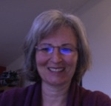
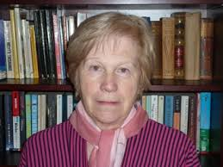
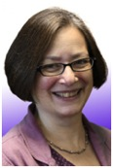
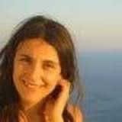
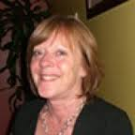
FE Digital Student Project Team
Prof. Rhona Sharpe, OCSLD
Dr. Greg Benfield, OCSLD
Prof. Elizabeth Browne, School of Education
Dr. Metaxia Pavlakou, OCSLD
Marilyn Hockley, independent consultant
Ellen Lessner, Jisc consultant
Notes:
Lets remind you the team…

Slide 4
Icebreaker
Introduce yourself to the person sat next to you
On a post-it record:
Why are you here, what do you want to take away from today
On another post-it:
Write down one challenge you experience in using technology with your learners in your college

Slide 5
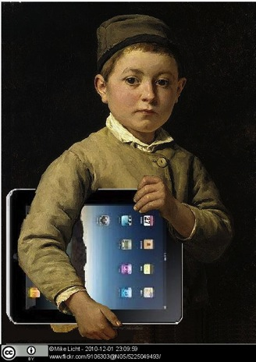
Aims of today – 3rd event out of 6
How should FE and Skills providers respond to learners' changing expectations of their digital environment?
What experiences prepare learners to flourish in a digital world?
What are providers doing to engage their learners in dialogue about their learning environment and to gather intelligence about their changing needs?
Who needs to be involved?
Notes:
This Jisc project is exploring FE learners’ expectations and experiences of technology and future work will expand the remit to the wider FE and Skills sector.
Building on earlier work, these consultation events are highly participative and will help answer questions such as:

Slide 6
FE Digital Student project
What do learners WANT (expectations) in relation to the digital?
What do learners NEED to succeed (experiences)?
Literature review| review of institutional data | stakeholder interviews | learner focus groups | consultation events
Guidance for colleges on how to gather learners’ views, how to engage learners in an ongoing dialogue about the digital and how to better support learners digital experience
Identify top challenges in relation to the digital learner experience and begin to develop a set of learner entitlements and enhancements to support colleges address these challenges

Slide 7
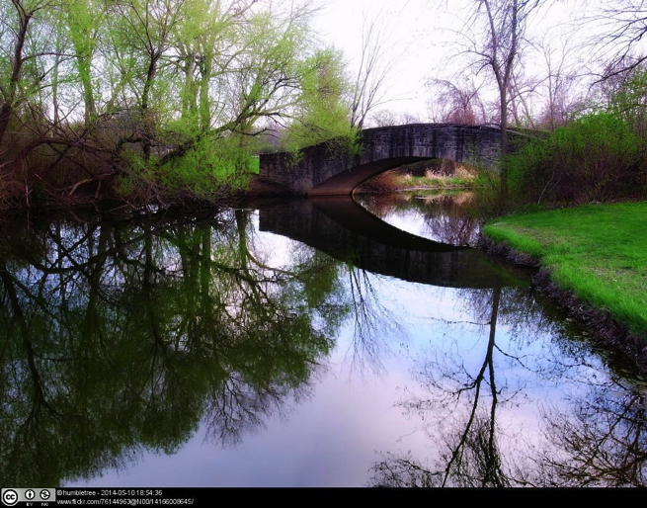
Reflection point – use your reflection form to note down actions and keep points for your return to college
Notes:
Reflection point slide for the end of each session for a reminder for delegates to look at their proforma reflection form.

Slide 8
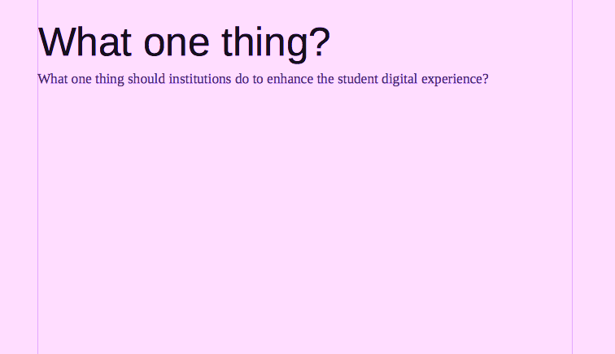
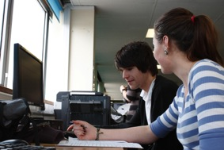
Throughout the day- have your say
What one thing should colleges/providers do to enhance learners’ digital experience?
Your idea here
What One thing? Padlet:
http://padlet.com/sarahknight/onething
#digitalstudent
Jisc Digital Student http://digitalstudent.jiscinvolve.org.uk
Notes:
8

Slide 9
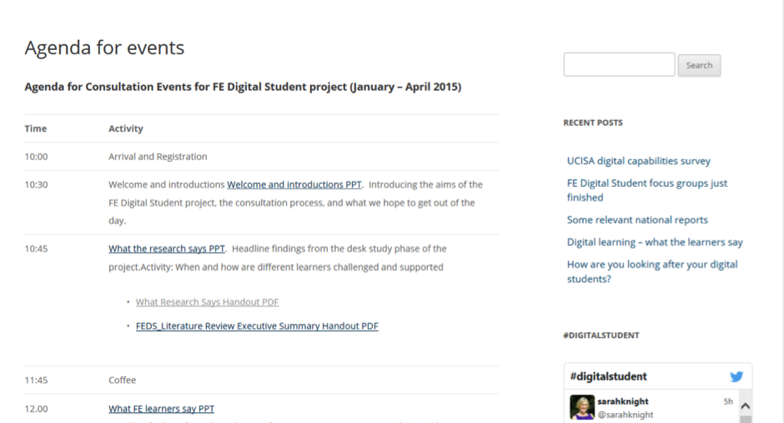
For findings and workshop resources:
http://digitalstudent.jiscinvolve.org
Notes:
All the resources are available on the Digital Student blog http://digitalstudent.jiscinvolve.org/wp/fe-and-skills-digital-student-study/agenda-for-events/
9

Slide 10
Find out more…
Digital Student #digitalstudent
Rhona Sharpe rsharpe@brookes.ac.uk
Sarah Knight
sarah.knight@jisc.ac.uk
http://digitalstudent.jiscinvolve.org
Except where otherwise noted, this work is licensed under CC-BY-NC-ND
Notes:
Go to ‘View’ menu > ‘Header and Footer…’ to edit the footers on this slide (click ‘Apply’ to change only the currently selected slide, or ‘Apply to All’ to change the footers on all slides).

