Slide 1


Session 6: Next Steps
Sarah Knight, Senior Co-design Manager, Student Experience, Jisc
Swansea
23/04//15
#digitalstudent http://digitalstudent.jiscinvolve.org

Slide 2
Reflection forms
Tweet using #digitalstudent
Notes:
Reflection point slide for the end of each session for a reminder for delegates to look at their proforma reflection form.

Slide 3
What one thing?
What would you most like Jisc/the sector bodies to do after today?
What does your college need to do? What help do you need from Jisc to do this?
http://padlet.com/sarahknight/onething

Slide 4
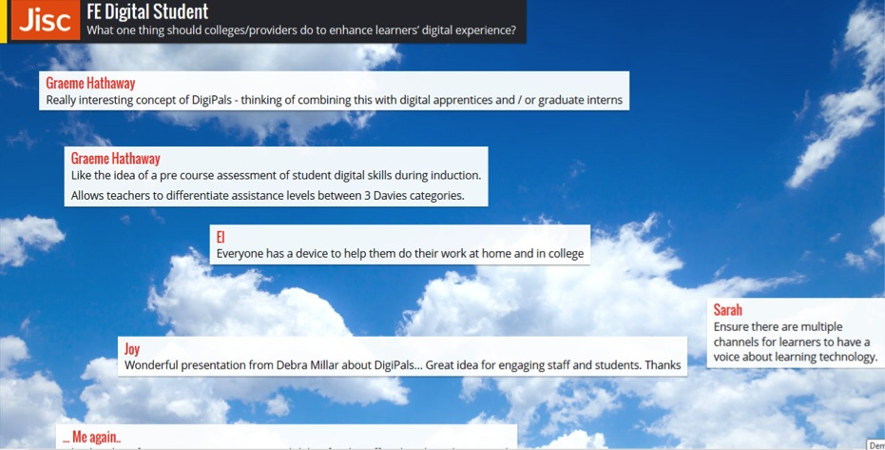

Slide 5
Change Agents’ Network http://can.jiscinvolve.org
Supporting staff – student partnership working and student engagement
Joining the network mailing list CAN@jiscmail.ac.uk by visiting http://www.jiscmail.ac.uk/CAN
Follow us on Twitter @CANagogy #JiscCAN
Visit our website for the CAN Student Partnerships Toolkit – resources to support staff-student partnership working http://tiny.cc/can001
Participate in the series of CAN webinars to share best practice
Share your experiences with us as part of the CAN case studies

Slide 6
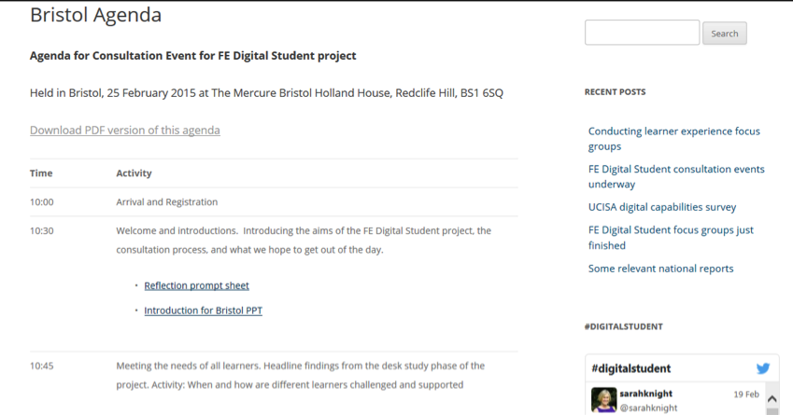
For findings and workshop resources:
http://digitalstudent.jiscinvolve.org
Notes:
Go to ‘View’ menu > ‘Header and Footer…’ to edit the footers on this slide (click ‘Apply’ to change only the currently selected slide, or ‘Apply to All’ to change the footers on all slides).
6

Slide 7
Digital students are different posters…

Slide 8
Enhancing the digital student experience

Slide 9
Consultation Events
http://bit.ly/FEDigitalstudentevents
Desk
research
Focus groups
Consultation
events
Date | Location & Venue
15 Jan 2015 | Birmingham The Studio B’ham, 3rd floor
20 Jan 2015 | Manchester The Studio Manchester
25 Feb 2015 | Bristol The Mercure Holland House Hotel Bristol
04 Mar 2015 | Edinburgh Training Centre, Scotland https://www.edintrain.com/
25 March 2015 | London Farringdon – The Hatton, 51-53 Hatton Garden http://www.etcvenues.co.uk/venues/the-hatton
23 April 2015 | Swansea, The Village Hotel

Slide 10
Find out more…
Digital Student #digitalstudent
Rhona Sharpe
rsharpe@brookes.ac.uk
Sarah Knight
Sarah.knight@jisc.ac.uk
http://digitalstudent.jiscinvolve.org
Except where otherwise noted, this work is licensed under CC-BY-NC-ND
Notes:
Go to ‘View’ menu > ‘Header and Footer…’ to edit the footers on this slide (click ‘Apply’ to change only the currently selected slide, or ‘Apply to All’ to change the footers on all slides).

