Slide 1
Gateshead College
#digitalstudent

Slide 2
some things that worked for us
(and might work for you)

Slide 3
ask

Slide 4
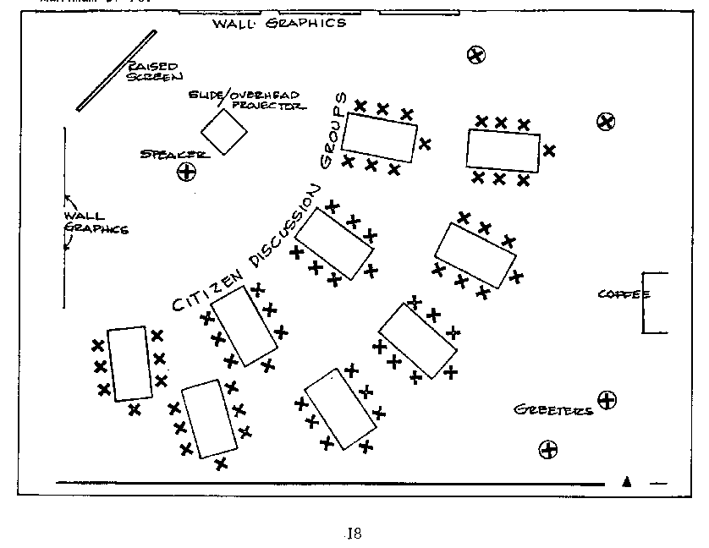
classroom layout
re-design IT rooms
advice and input
presenting ideas

Slide 5
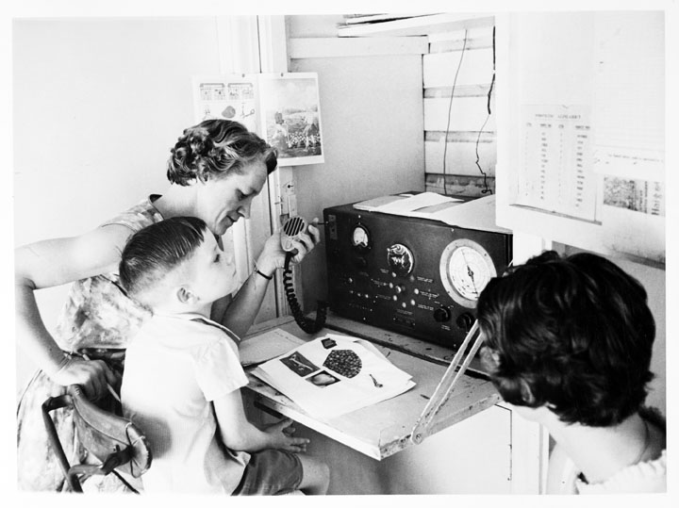
access anywhere
access to their work
VLE
BYOD
book a Library PC

Slide 6
self review
using Apple TV to record sessions

Slide 7
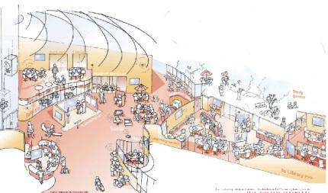
Evolve your
learning spaces

Slide 8
how?
understand
imagine
design
create

Slide 9
service design project
enquiry to enrolment
multi-channel
keep in touch
added value events
defining great service

Slide 10
Gateshead College
#digitalstudent
@2265

