Slide 1
What do FE Learners say? Dr Greg Benfield
Birmingham,
15/01/15
#digitalstudent http://digitalstudent.jiscinvolve.org

Slide 2
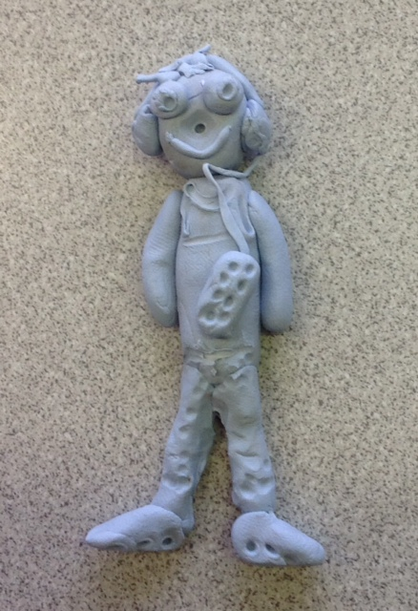
Focus Groups
We conducted 12 Focus groups at 6 colleges, comprising 220 learners from:
Child Health and Social Care (Level 3, L1B & Higher)
Creative Media (vocational)
Animal Management (vocational)
IT (Level 3)
Sociology (AS & A2)
Notes:
+ we did a pilot focus group
Colleges in England, Scotland and Wales. Most learners were co-operative, articulate and willing to engage (some exceptions, classroom mngmt skills needed)
We saw learners in cohort groups because...
We tried to look at incoming and outgoing expectations but didn’t find much differences between Y1 and Y2 learners.
We looked at a range of qualifications. Didn’t find much difference there, but did find differences between subjects, which is worthy of further investigation
22/12/14 – emailed Marilyn to ask for details of the qualifications the learners were studying.

Slide 3
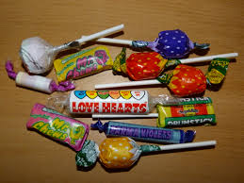
Focus group protocol
Tools
Learner profile
Protocol
Card sort
Skills
What we learnt about conducting research in the FE setting
Notes:
Chance to see and use the tools this afternoon
Sweets on the tables, good icebreaker

Slide 4
7 key findings
On your table you will find an envelope with the 7 key findings.
Discuss each one in turn.
What would we have to do to meet these challenges?
What actions would be needed?
Write all your ideas onto post-its
(one idea per post-it)
Notes:
Might not get through all 7 findings.

Slide 5
Process improvement prioritization
Low impact
High resources
High impact
High resources
Place your post-its
Resources
Low impact
Low resources
High impact
Low resources
Impact
Notes:
Place each post it at an appropriate place in the grid.
What does this tell us about what we need to do first?
You can play with these grids, choosing different axes e.g. urgency, achievability, benefits.

Slide 6
Reporting back
What to do first?
Notes:
What came out as high priority?
What is in the bottom right hand corner of your grid? (low resource, high impact)

