Slide 1
Further Education Digital Student Project Sarah Knight, Senior Co-design Manager, Student Experience, Jisc
Birmingham,
15/10/14
#digitalstudent http://digitalstudent.jiscinvolve.org

Slide 2
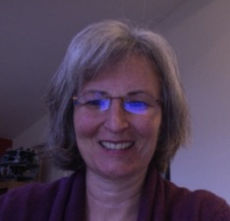
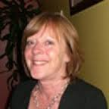
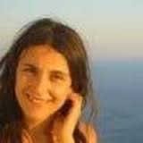
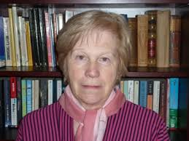
FE Digital Student Project Team
Professor Rhona Sharpe, OCSLD
Dr. Greg Benfield, OCSLD
Dr. Elizabeth Browne, School of Education,
Dr. Metaxia Pavlakou, OCSLD
Marilyn Hockley, independent consultant
Notes:
Lets remind you the team…

Slide 3
Consultation Events
Desk
research
Focus groups
Consultation
events
Date | Location & Venue
15 Jan 2015 | Birmingham The Studio B’ham, 3rd floor
20 Jan 2015 | Manchester The Studio Manchester
25 Feb 2015 | Bristol The Mercure Holland House Hotel Bristol
04 Mar 2015 | Edinburgh Training Centre, Scotland https://www.edintrain.com/
25 March 2015 | London Farrington – The Hatton, 51-53 Hatton Garden http://www.etcvenues.co.uk/venues/the-hatton
23 April 2015 | Wales tba

Slide 4
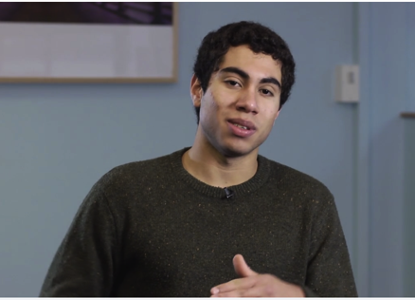
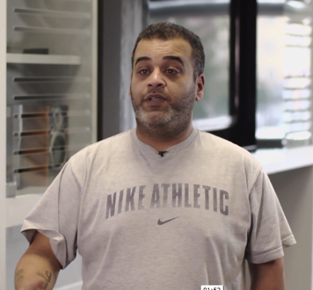
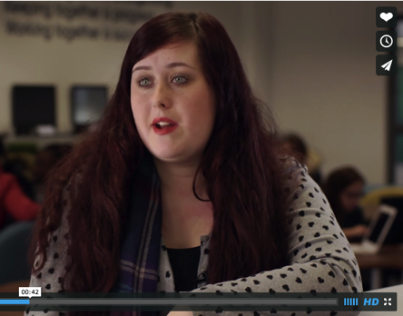
Learner Voices
Notes:
Learner Voice videos
http://vimeo.com/116647287

Slide 5
Aims of today
How should FE and Skills providers respond to learners' changing expectations of their digital environment?
What experiences prepare learners to flourish in a digital world?
What are providers doing to engage their learners in dialogue about their learning environment and to gather intelligence about their changing needs?
Notes:
This Jisc project is exploring FE learners’ expectations and experiences of technology and future work will expand the remit to the wider FE and Skills sector.
Building on earlier work, these consultation events are highly participative and will help answer questions such as:

Slide 6
Agenda

Slide 7
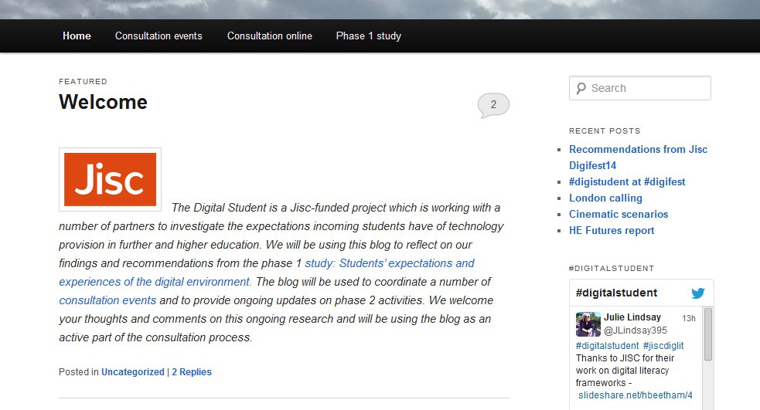
For conclusions and recommendations:
http://digitalstudent.jiscinvolve.org
Notes:
Go to ‘View’ menu > ‘Header and Footer…’ to edit the footers on this slide (click ‘Apply’ to change only the currently selected slide, or ‘Apply to All’ to change the footers on all slides).
7

Slide 8
Find out more…
Digital Student #digitalstudent
Rhona Sharpe rsharpe@brookes.ac.uk
Sarah Knight
sknight@jisc.ac.uk
http://digitalstudent.jiscinvolve.org
Except where otherwise noted, this work is licensed under CC-BY-NC-ND
Notes:
Go to ‘View’ menu > ‘Header and Footer…’ to edit the footers on this slide (click ‘Apply’ to change only the currently selected slide, or ‘Apply to All’ to change the footers on all slides).

