Slide 1
What do FE Learners say? Dr Greg Benfield
Birmingham,
15/01/15
#digitalstudent http://digitalstudent.jiscinvolve.org

Slide 2
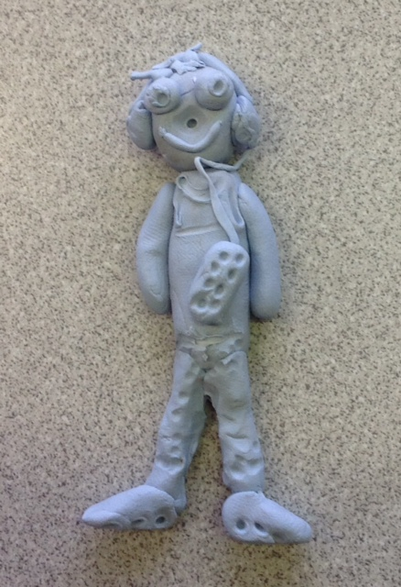
Focus Groups
We conducted 12 Focus groups at 6 colleges, comprising 220 learners from:
Child Health and Social Care (Level 3, L1B & Higher)
Creative Media (vocational)
Animal Management (vocational)
IT (Level 3)
Sociology (AS & A2)
Notes:
+ we did a pilot focus group
Colleges in England, Scotland and Wales. Most learners were co-operative, articulate and willing to engage (some exceptions, classroom mngmt skills needed)
We saw learners in cohort groups because...
We tried to look at incoming and outgoing expectations but didn’t find much differences between Y1 and Y2 learners.
We looked at a range of qualifications. Didn’t find much difference there, but did find differences between subjects, which is worthy of further investigation
22/12/14 – emailed Marilyn to ask for details of the qualifications the learners were studying.

Slide 3
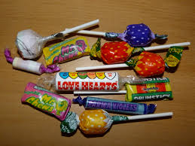
Focus group protocol
Tools
Learner profile
Protocol
Card sort
Skills
What we learnt about conducting research in the FE setting
Notes:
Chance to see and use the tools this afternoon
Sweets on the tables, good icebreaker

Slide 4
7 Key themes
Don’t assume we are digitally literate
We expect college to provide what we need…
We need ongoing development
We expect modern learning resources that are easy to find and use
We expect the same (or better) services as in school…
Ask us what we need…
We want to work with lecturers…

Slide 5
Responses to findings
Each table has been allocated two key findings
Discuss each one in turn
What would we have to do to meet these challenges?
What actions would be needed?
List your ideas onto flip chart
Prioritise your actions

Slide 6
Reporting back
What to do first?
Notes:
What came out as high priority?

